Slide 1
A lap around Azure AD B2C custom policies
Rory Braybrook
Microsoft Identity Architect
@rbrayb

Slide 2
Azure AD / Azure AD B2C
Azure AD
Company employees
On-premises AD synced to Azure AD via AAD Connect
Domain joined email address
Access to Azure SaaS e.g. Microsoft 365
5 guest users per Azure AD account

Slide 3
Azure AD / Azure AD B2C
Azure AD B2C
Customers
Not in on-premises AD
Any email address – Gmail / Hotmail
No access to SaaS
No AAD Connect

Slide 4
Azure AD B2C
Provides:
Self service registration (Sign up)
Sign in
Self service password reset
Self service profile edit
Zero help desk involvement
Scales to hundreds of millions of users
Priced appropriately – first 50,000 users free

Slide 5
Azure AD B2C protocols
In:
Open ID Connect (OAuth)
MSAL library - .NET / .NET Core / Java / iOS / Android / React / Mobile native …
Out
Open ID Connect (OAuth)
SAML 2.0
Various social providers – Facebook, Google, LinkedIn, Twitter …
Custom OpenID Connect
No WS-Federation currently

Slide 6
Built-in policies
Demo

Slide 7
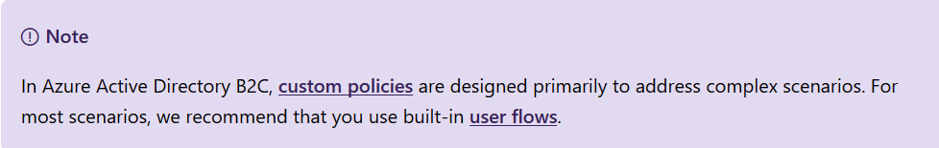
Custom policies
Allow user to customise journey? Passport? Driver’s licence?
ADFS 2.0 – “disaster”
Identity Experience Framework (IEF)
XML as code

Slide 8
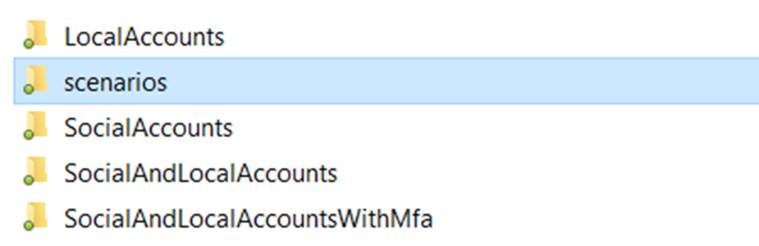
Custom policies – getting started
Get started with custom policies in Azure Active Directory B2C
Starter pack

Slide 9
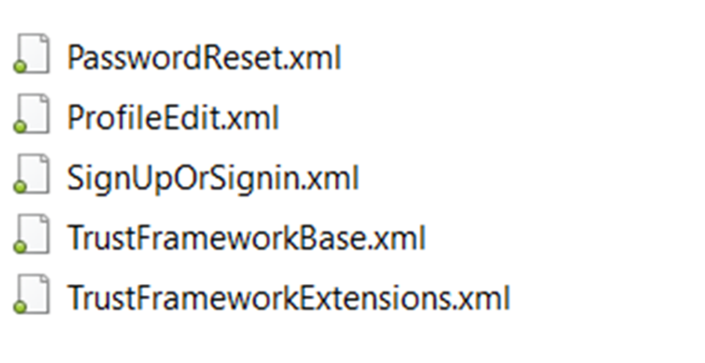
Custom policies – getting started
Starter pack

Slide 10
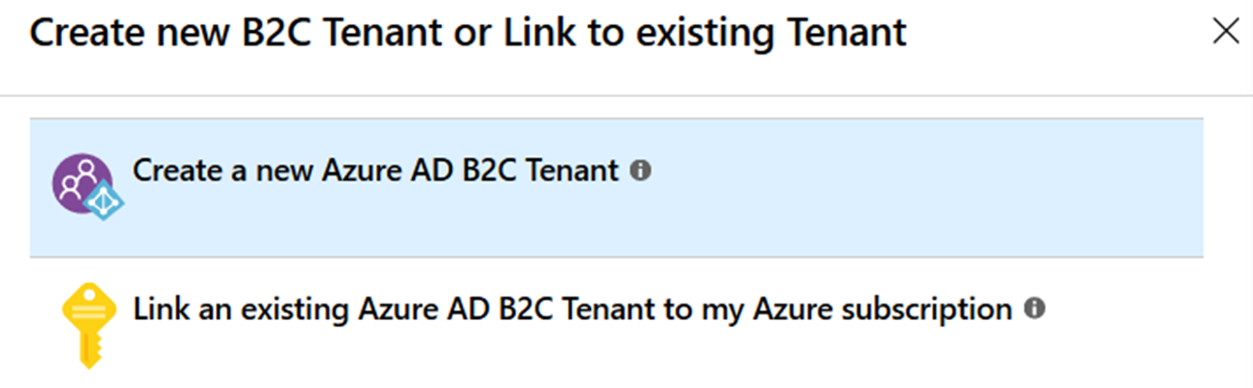
Create a tenant

Slide 11
IEF – setup applications
Create application registrations in Azure AD
Create applications in Azure AD B2C
Setup keys
Copy GUID’s in custom policy

Slide 12
IEF – custom policy upload
“Compiling”
Checks against xsd
Checks e.g. that declared “variables” have been defined

Slide 13
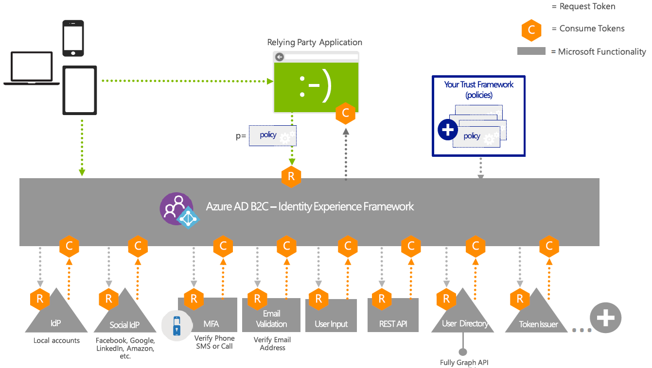
IEF Overview

Slide 14
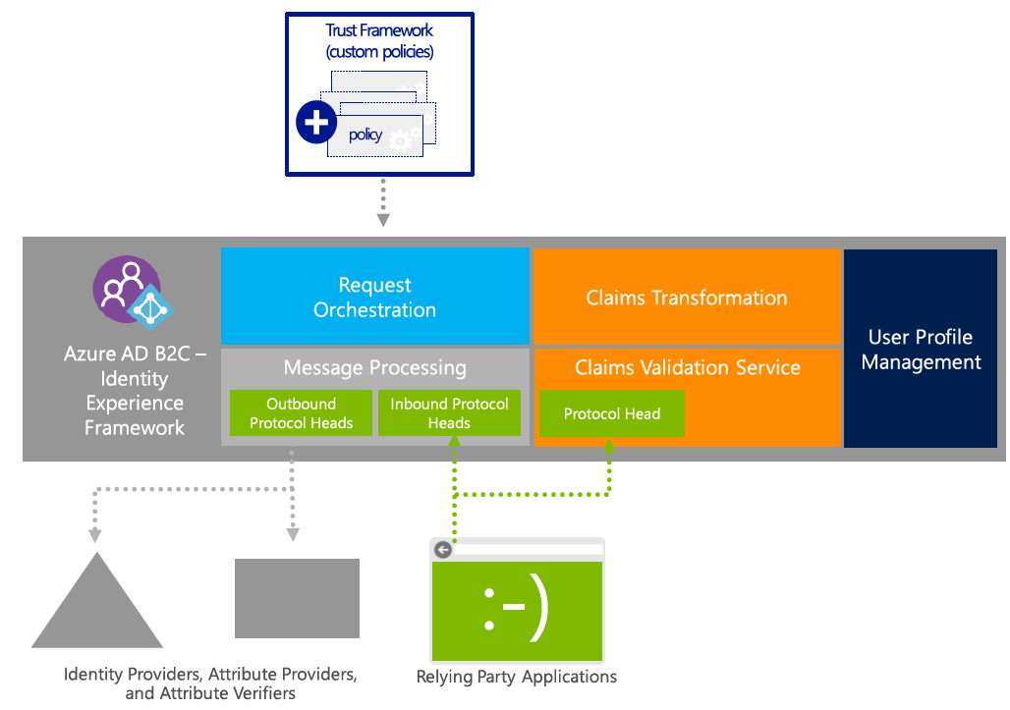
IEF Core Functions

Slide 15
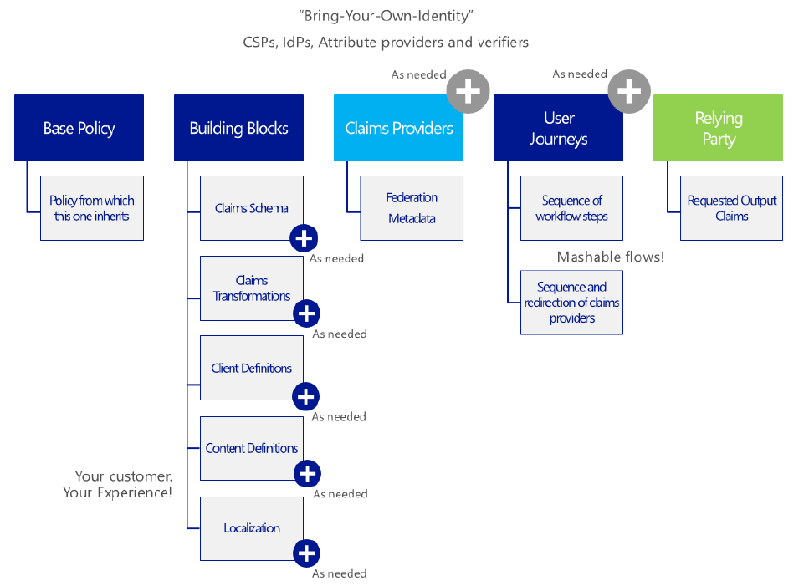
IEF - BYOI

Slide 16
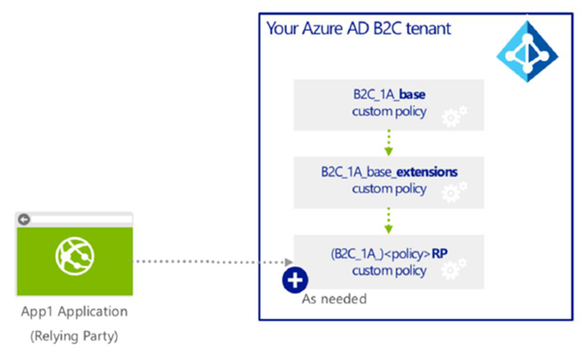
IEF Inheritance

Slide 17
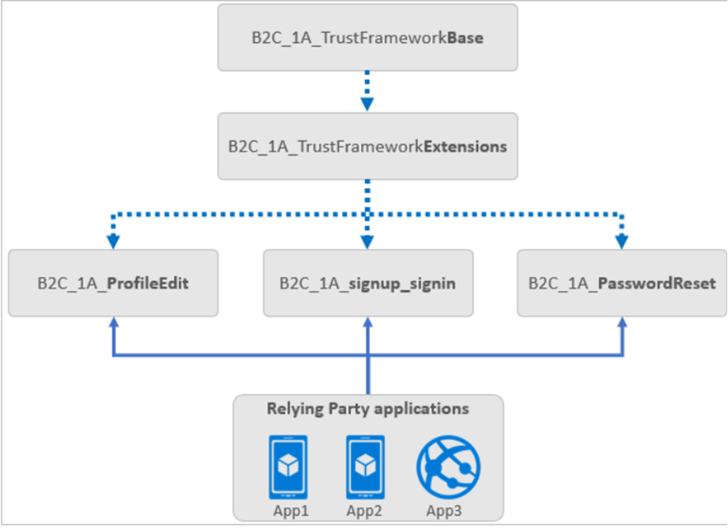
Policy flow

Slide 18
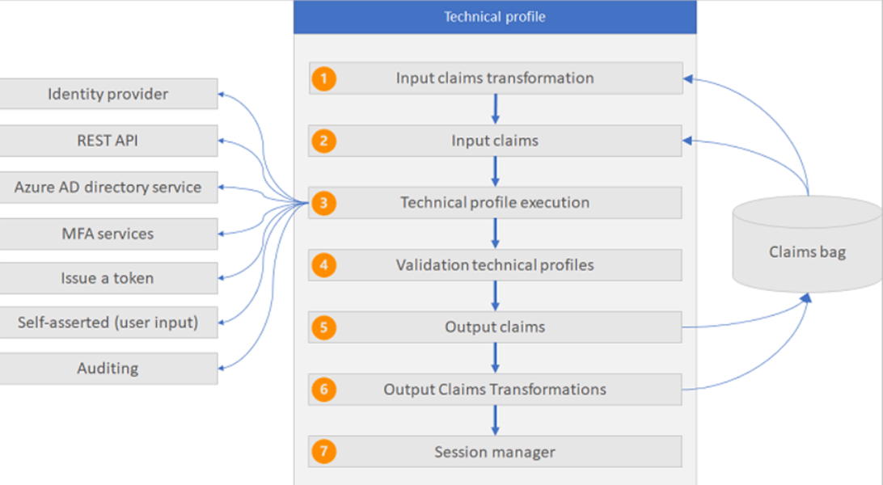
Technical Profiles

Slide 19
Self-asserted TP
All interactions in AAD B2C where the user is expected to provide input are self-asserted technical profiles. For example, a sign-up page, sign-in page, or password reset page.
In a self-asserted technical profile, you can use the InputClaims and InputClaimsTransformations elements to prepopulate the value of the claims that appear on the self-asserted page (output claims).
Output claims
Collecting the output claims from the user
Setting a default value in an output claim
A validation technical profile returns the output claims
Output the claims via output claims transformation
Persisted claims
Used to persist the data to Azure AD B2C.

Slide 20
Validation TP
A validation technical profile is used for validating some or all of the output claims of the referencing technical profile.
Claims that are returned from a validation technical profile are added back to the claims bag. You can use those claims in the next validation technical profiles.

Slide 21
Claims transformation TP
A claims transformation technical profile enables you to call output claims transformations to manipulate claims values, validate claims, or set default values for a set of output claims.
Types
Boolean
Date
Integer
JSON
General
Social account
String
StringCollection

Slide 22
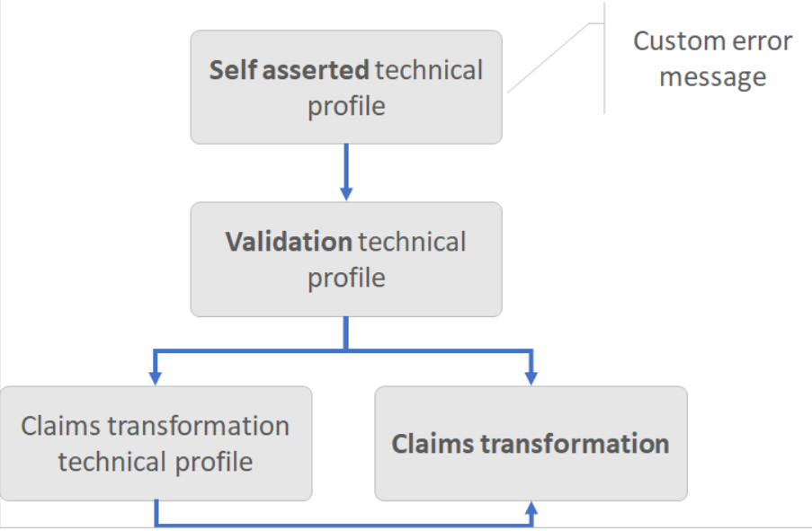
Claims transformation

Slide 23
Claims transformation TP - Example – Boolean
<ClaimsTransformation Id="AssertAccountEnabledIsTrue" TransformationMethod="AssertBooleanClaimIsEqualToValue">
<InputClaims>
<InputClaim ClaimTypeReferenceId="accountEnabled" TransformationClaimType="inputClaim" />
</InputClaims>
<InputParameters>
<InputParameter Id="valueToCompareTo" DataType="boolean" Value="true" />
</InputParameters>
</ClaimsTransformation>

Slide 24
Claims transformation TP - Example – String
<ClaimsTransformation Id="ChangeToLower" TransformationMethod="ChangeCase">
<InputClaims>
<InputClaim ClaimTypeReferenceId="email" TransformationClaimType="inputClaim1" />
</InputClaims>
<InputParameters>
<InputParameter Id="toCase" DataType="string" Value="LOWER" />
</InputParameters>
<OutputClaims>
<OutputClaim ClaimTypeReferenceId="email" TransformationClaimType="outputClaim" />
</OutputClaims>
</ClaimsTransformation>

Slide 25
User Journeys
User journeys specify explicit paths through which a policy allows a relying party application to obtain the desired claims for a user.
The user is taken through these paths to retrieve the claims that are to be presented to the relying party.
User journeys define the business logic of what an end user goes through as the Azure AD B2C IEF processes the request.
Series of steps – can be skipped
<OrchestrationStep Order="2" Type="ClaimsExchange">
<Preconditions>
<Precondition Type="ClaimsExist" ExecuteActionsIf="true">
<Value>objectId</Value>
<Action>SkipThisOrchestrationStep</Action>
</Precondition>

Slide 26
Relying Party
This specifies the user journey to enforce for the current request to Azure Active Directory (Azure AD) B2C.
It also specifies the list of claims that the relying party (RP) application needs as part of the issued token.
An RP application, such as a web, mobile, or desktop application, calls the RP policy file.
The RP policy file executes a specific task, such as signing in, resetting a password, or editing a profile.
Multiple applications can use the same RP policy and a single application can use multiple policies.
All RP applications receive the same token with claims, and the user goes through the same user journey.

Slide 27
Claims Providers
A claims provider contains a set of TP.
Every claims provider must have one or more technical profiles that determine the endpoints and the protocols needed to communicate with the claims provider.
A claims provider can have multiple technical profiles.

Slide 28
The flow
<RelyingParty> <DefaultUserJourney ReferenceId="SignUpOrSignIn" />
<UserJourney Id="SignUpOrSignIn">
<OrchestrationStep Order="1“ ContentDefinitionReferenceId="api.signuporsignin">
TP - SelfAsserted-LocalAccountSignin-Email
<ValidationTechnicalProfile ReferenceId="login-NonInteractive" />
TP – Order=“2“ – LocalAccountSignUpWithLogonEmail
<ValidationTechnicalProfile ReferenceId="AAD-UserWriteUsingLogonEmail" />
REST API
TP - Order=“3“ - AAD-UserReadUsingObjectId
TP - Order=“4“ – JwtIssuer
Extension attributes

Slide 29
IEF demo
Sign up not sign in relying party
Branding
User Journey with TP
Validate password using Troy Hunt’s “Pwned Password” via REST API

Slide 30
Built-in policy retrospective
Built-in policies are custom policies that can be downloaded but not uploaded

Slide 31
IEF utilities

Slide 32
Resources
Get started with custom policies in Azure Active Directory B2C
Gaining Expertise with Azure AD B2C course for developers
GitHub utilities
Azure AD B2C blog articles
Tips and tricks for working with custom policies in Azure AD B2C
Azure AD B2C documentation

Slide 33


